Slide 1



Meet The Team
SKYNET
Introducing the exceptional team behind the groundbreaking solution known as Person Protection Equipment (PPE). These brilliant minds, consisting of developers, data scientists, and visionaries, have united with a common goal: to redefine the way we ensure safety in the workplace.
Atul Ukey
Tanish Jain
Sobhan Bhowmick

Slide 2
Problem Statement
Assumptions
Recent times have witnessed a rise in crimes and suspicious activities, causing concerns about the safety and security of individuals within their homes. The need for an advanced camera surveillance system that can efficiently detect and respond to accidents, criminal, suspicious or anomalous activities around households has become paramount. This project aims to develop a software solution that utilizes modern technologies to address this security challenge. The software will detect unauthorized individuals, identify potentially harmful weapons, and promptly notify homeowners of any unusual activities, enhancing overall safety and peace of mind.
Cameras will be strategically placed in and around households for monitoring and security.
Cameras will cover crucial areas to provide a comprehensive view.
The software requires a reliable internet connection for data transmission.
Users need compatible devices for receiving alerts and notifications.
The software will have a predefined list of authorized individuals for person identification.

Slide 3
Our Approach
 | App Logic
01 | Stream and display live camera feeds in the app's designated interface.
02 | Activate facial recognition algorithms to identify individuals in the camera feed.
03 | Employ machine learning models to analyze the video feed for suspicious activities and hazardous weapons.
04 | Generate and send detailed alerts specifying the detected activity or weapon to the user.
05 | Log all detected events, alerts, and user interactions for future reference and analysis.
06 | Enable remote access to the surveillance system via a secure connection.
07 | Provide options for the user to take appropriate actions (e.g., call authorities, sound alarms, or dismiss non-critical alerts).
Intelligent Home Surveillance and Security System
Objective:
Enhance home security through real-time monitoring and immediate alerts for potential threats.
Key Features:
Real-time Surveillance:The system provides live video feeds for real-time monitoring of the surroundings.
Facial Recognition:Utilizes facial recognition to verify the identity of individuals approaching the premises.
Activity Detection:Detects and alerts on various suspicious or criminal activities in the vicinity.
Weapon Detection:Identifies hazardous weapons in the camera's field of view and promptly notifies the user.
Alert Notifications:Sends immediate alerts and notifications to the homeowner in case of any detected threat or anomaly or accidents.
Remote Access:Allows homeowners to monitor their property remotely via a user-friendly interface on their devices.
Technology Stack:Python, OpenCV, TensorFlow, or PyTorch, LBPHFaceRecognizer, DenseNet, YOLOv8 etc..

Slide 4
Details about the models
 | Model Name | Model Type | Framework | Input Format and Shape | Output | Custom Tweaks
Primary Model Architecture | DenseNet | Classification | tensorflow-keras | NCHW 1 x 3 x 224x 224 | Class detected | Try to add maximum number of classes.
Primary Model Architecture | YOLOv8 | Detection | Pytorch | NCHW 1 x 3 x 224x 224 | Anchor free | Try to add maximum number of classes.
Secondary Model Architecture | LBPHFaceRecognizer | Face Recognizer | OpenCV | 1 x 3 x 100 x 100 | Binary output

Slide 5
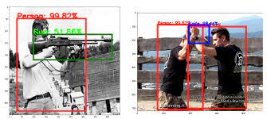
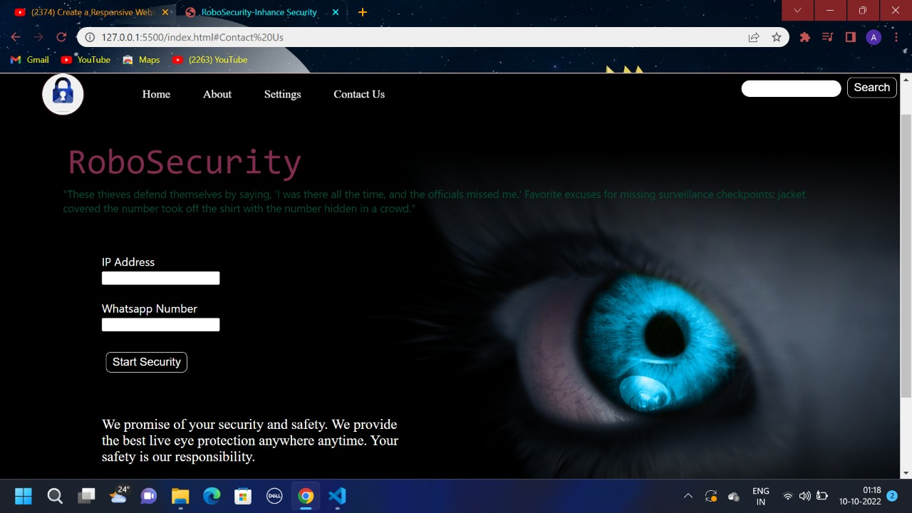
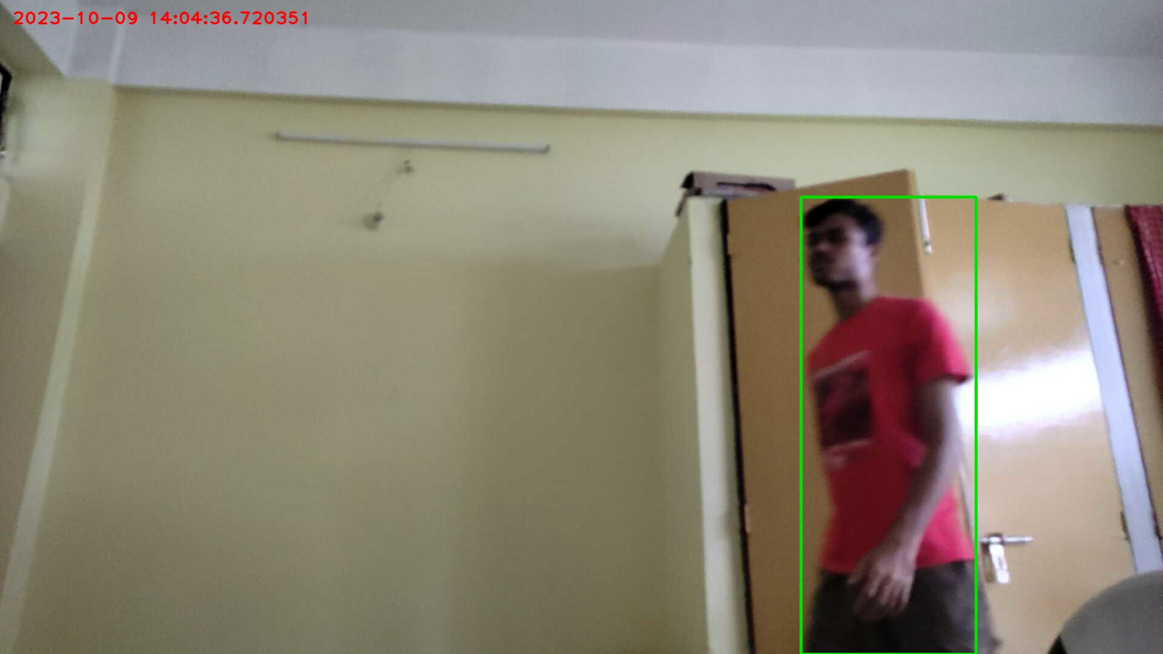
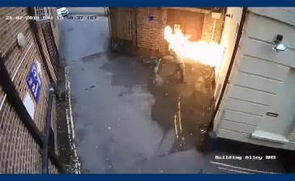
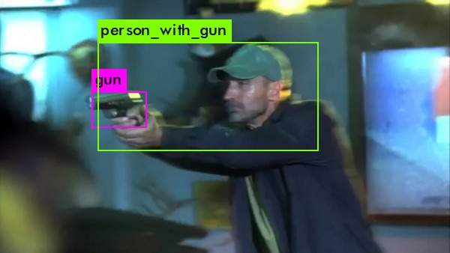
PPE In Action
Link to the video:- https://github.com/sbhowmick1204/demo_video_Skynet.git

Slide 6
Thank You

